Slide 1
Attributes as Intermediate Representation for Categorization

Slide 2
Farhadi et. al. Describing Objects by their Attributes, CVPR 2009

Slide 3
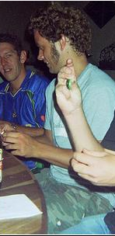
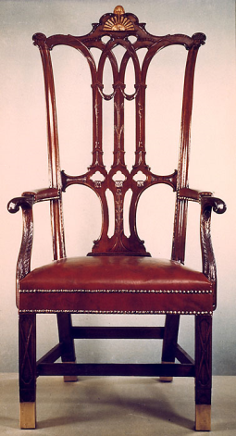
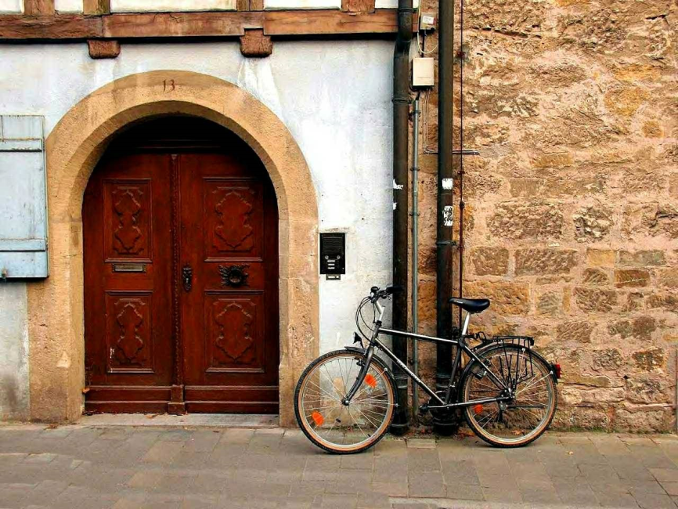
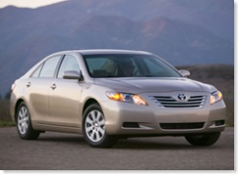
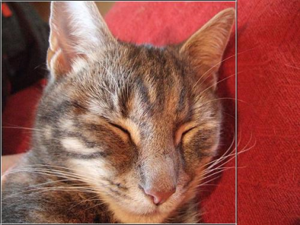
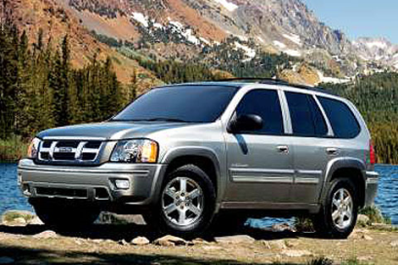
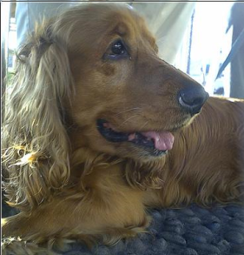
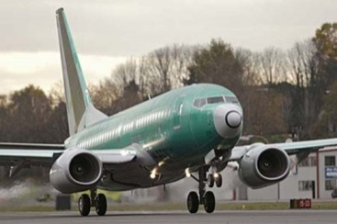
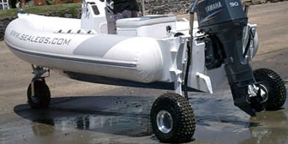
Learning Attributes
Simplest approach: Train classifier using all features for each attribute independently
“Has Wheels”
“No Wheels Visible”
Farhadi et. al. Describing Objects by their Attributes, CVPR 2009

Slide 4
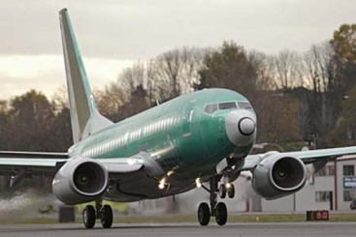
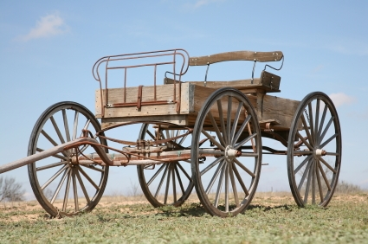
Dealing with Correlated Attributes
Big Problem: Many attributes are strongly correlated through the object category
Most things that “have wheels” are “made of metal”
When we try to learn “has wheels”, we may accidentally learn “made of metal”
Has Wheels, Made of Metal?
Farhadi et. al. Describing Objects by their Attributes, CVPR 2009

Slide 5
Decorrelating attributes
Solution:
Select features that can distinguish between two classes
Things that have the attribute (e.g., wheels)
Things that do not, but have similar attributes to those that do
Then, train attribute classifier on all positive and negative examples using the selected features
Farhadi et. al. Describing Objects by their Attributes, CVPR 2009

Slide 6
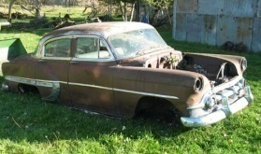
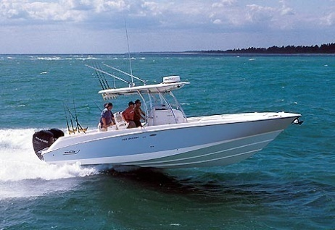

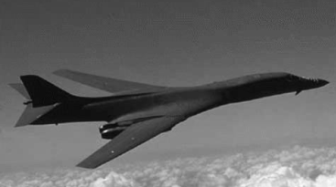
Feature Selection
Do feature selection (L1 logistic regression) for each class separately and pool features
vs.
Car Wheel Features
vs.
Boat Wheel Features
Plane Wheel Features
vs.
“Has Wheels”
“No Wheels”
All Wheel Features
Farhadi et. al. Describing Objects by their Attributes, CVPR 2009

Slide 7
Feature selection
“Has Wheel” vs. “Made of Metal” Correlation
Ground truth
a-Pascal: 0.71 (cars, airplanes, boats, etc.)
a-Yahoo: 0.17 (carriages)
a-Yahoo, predicted with whole features: 0.56
a-Yahoo, predicted with selected features: 0.28
Farhadi et. al. Describing Objects by their Attributes, CVPR 2009

Slide 8
Experiments
Predict attributes for unfamiliar objects
Learn new categories
From limited examples
Learn from verbal description alone
Identify what is unusual about an object
Provide evidence that we really learn intended attributes, not just correlated features
Farhadi et. al. Describing Objects by their Attributes, CVPR 2009

Slide 9
Category Recognition
Semantic attributes not enough
74% accuracy even with ground truth attributes
Introduce discriminative attributes
Trained by selecting subset of classes and features
Dogs vs. sheep using color
Cars and buses vs. motorbikes and bicycles using edges
Train 10,000 and select 1,000 most reliable, according to a validation set
Farhadi et. al. Describing Objects by their Attributes, CVPR 2009

Slide 10
Attributes not big help when sufficient data
Use attribute predictions as features
Train linear SVM to categorize objects
PASCAL 2008 | Base Features | Semantic Attributes | All Attributes
Classification Accuracy | 58.5% | 54.6% | 59.4%
Class-normalized Accuracy | 35.5% | 28.4% | 37.7%
Farhadi et. al. Describing Objects by their Attributes, CVPR 2009

Slide 11
Learning New Categories
From limited examples
nearest neighbor of attribute predictions
From verbal description
nearest neighbor to verbally specified attributes
Goat: “has legs, horns, head, torso, feet”, “is furry”
Building: “has windows, rows of windows”, “made of glass, metal”, “is 3D boxy”
Farhadi et. al. Describing Objects by their Attributes, CVPR 2009

Slide 12
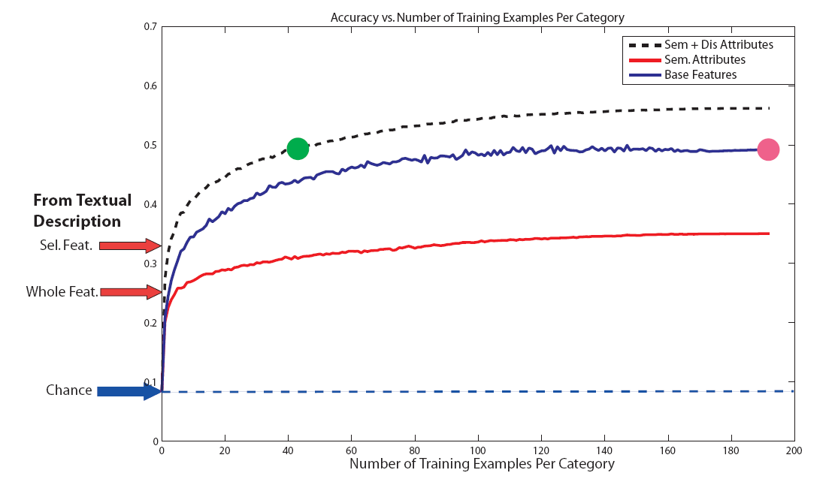
Recognition of New Categories
Farhadi et. al. Describing Objects by their Attributes, CVPR 2009

Slide 13
How do we know if we learn what we intend?
Dataset biases and natural correlations can create an illusion of a well-learned model.
Farhadi et. al. Describing Objects by their Attributes, CVPR 2009

Slide 14
Feature selection improves classifier semantics
Learning from textual description:
Selected features: 32.5%
Whole features: 25.2%
Absence of typical attributes:
Selected features: 68.2%
Whole features: 54.8%
Presence of atypical attributes:
Selected features: 47.3%
Whole features: 24.5%
Farhadi et. al. Describing Objects by their Attributes, CVPR 2009

Slide 15
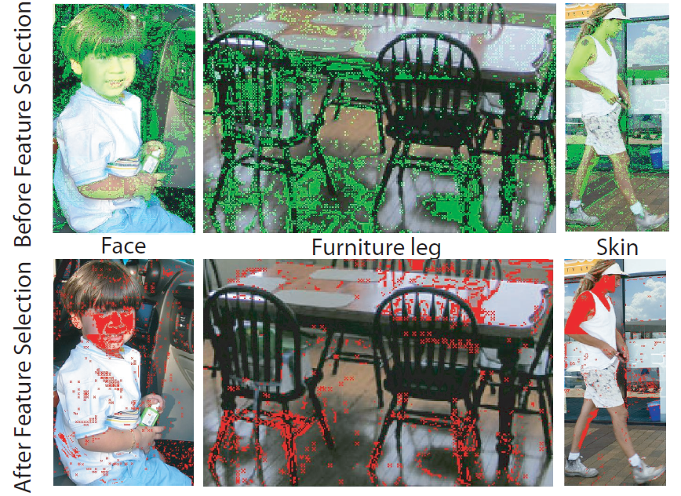
Attribute Localization
Farhadi et. al. Describing Objects by their Attributes, CVPR 2009

Slide 16
Unusual attribute localization
Farhadi et. al. Describing Objects by their Attributes, CVPR 2009

Slide 17
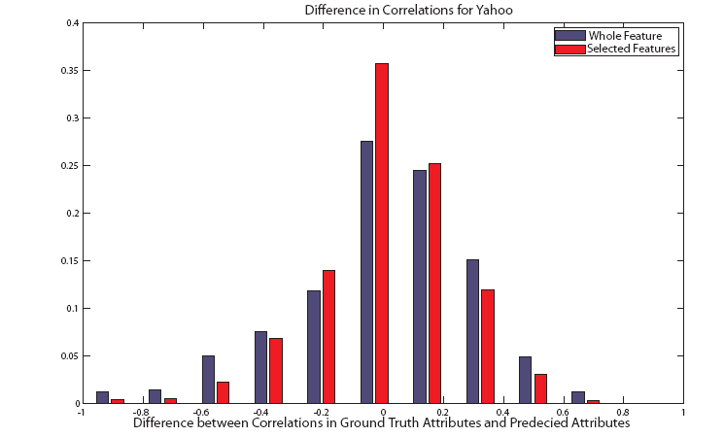
Correlation of Attributes
Farhadi et. al. Describing Objects by their Attributes, CVPR 2009

Slide 18
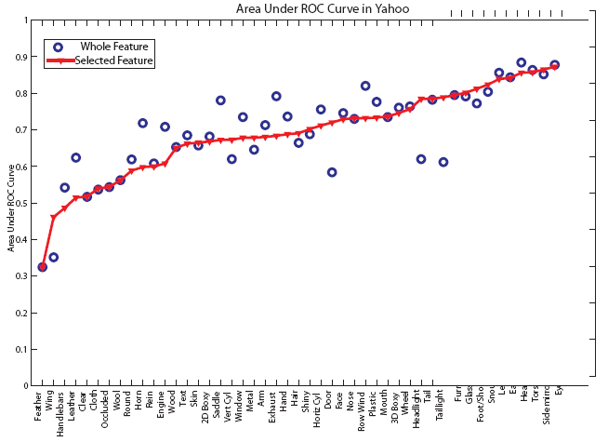
Better semantics does not necessarily lead to higher overall accuracy
Train on 20 PASCAL classes
Test on 12 different Yahoo classes
Farhadi et. al. Describing Objects by their Attributes, CVPR 2009

Slide 19
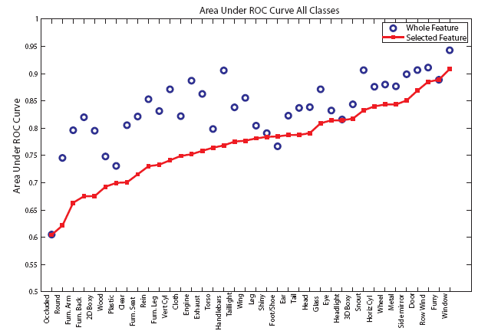
Learning the wrong thing sometimes gives much better numbers
Train and Test on Same Classes from PASCAL
Farhadi et. al. Describing Objects by their Attributes, CVPR 2009

Slide 20
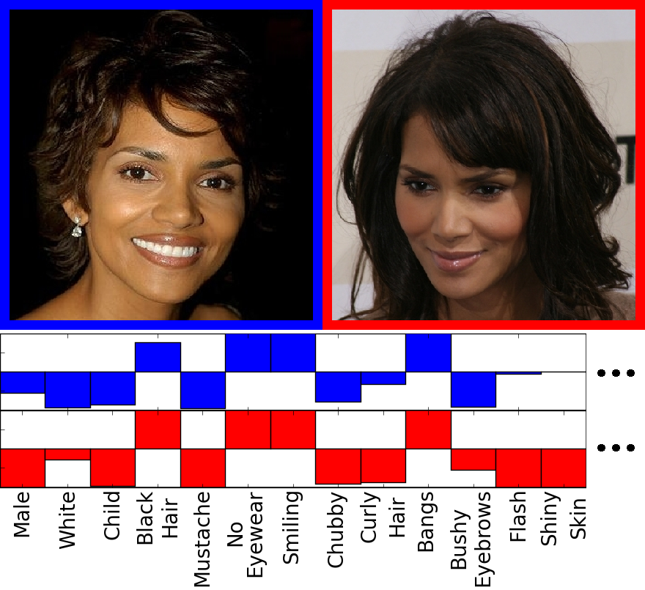
Using attributes to perform verification
Verification
classifier
Kumar et. al. ICCV09
Slide: Neeraj Kumar

Slide 21
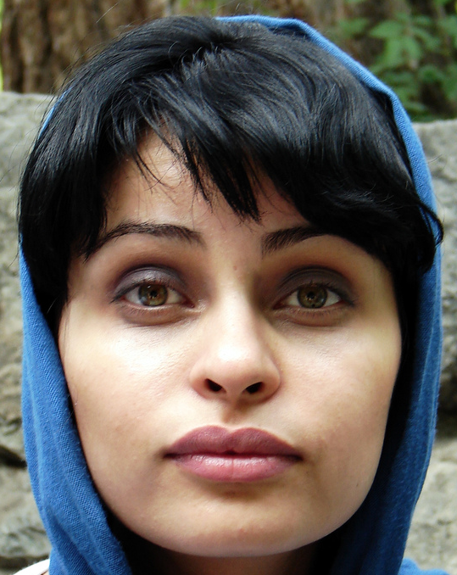
Attributes are intuitive
Female
Black hair
Young
Frontal pose
Attractive
Mouth closed
White
Eyes open
Kumar et. al. ICCV09
Slide: Neeraj Kumar

Slide 22

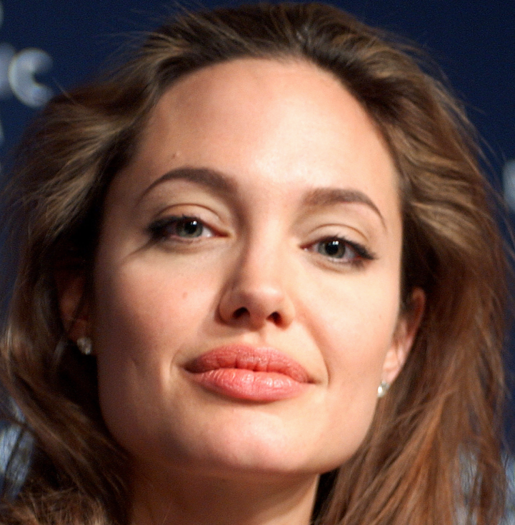
Describe faces using similes
Penelope Cruz
Angelina Jolie
Kumar et. al. ICCV09
Slide: Neeraj Kumar

Slide 23
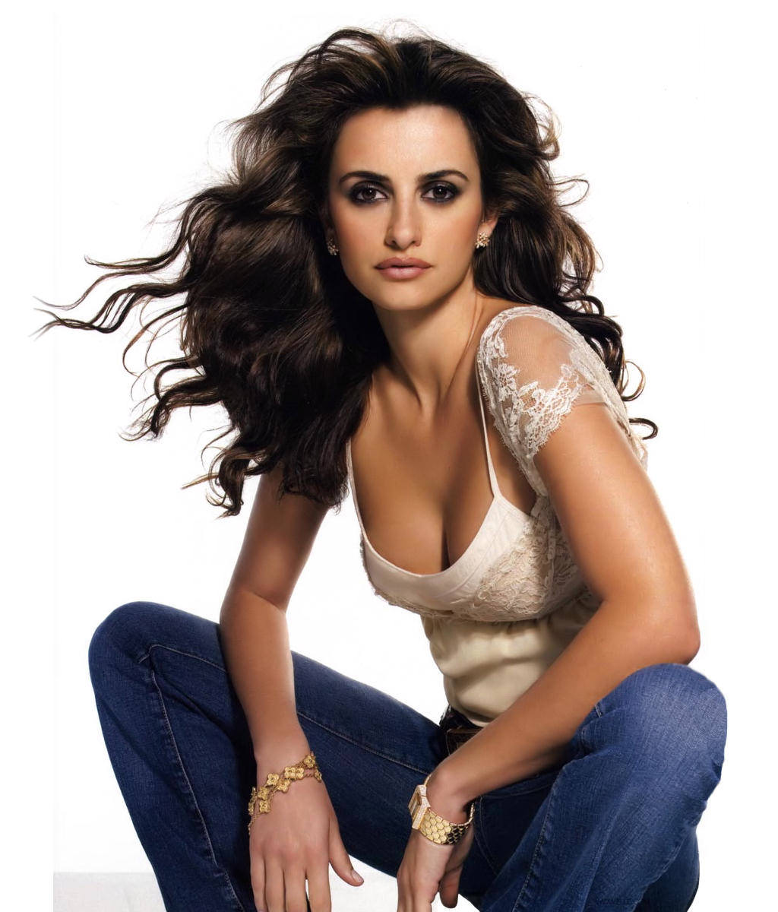
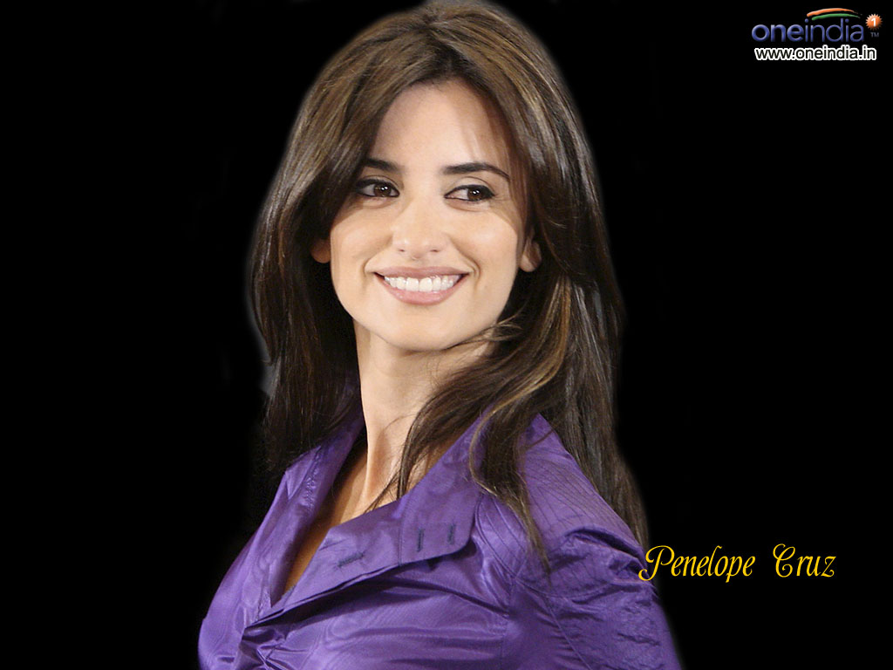
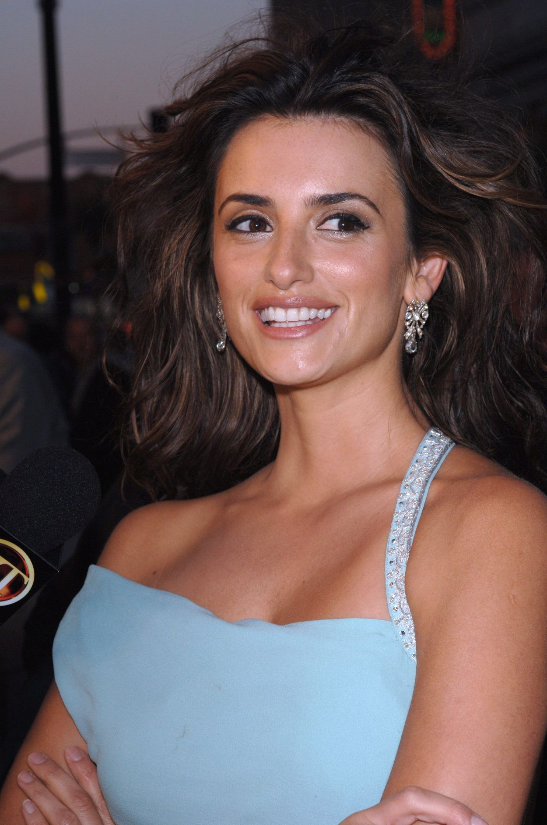
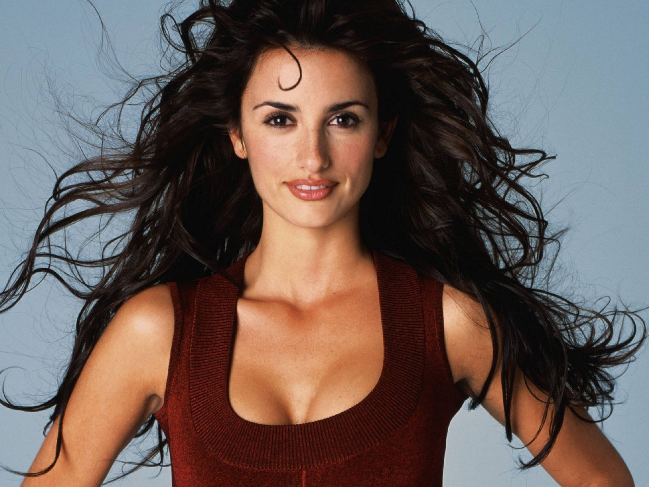
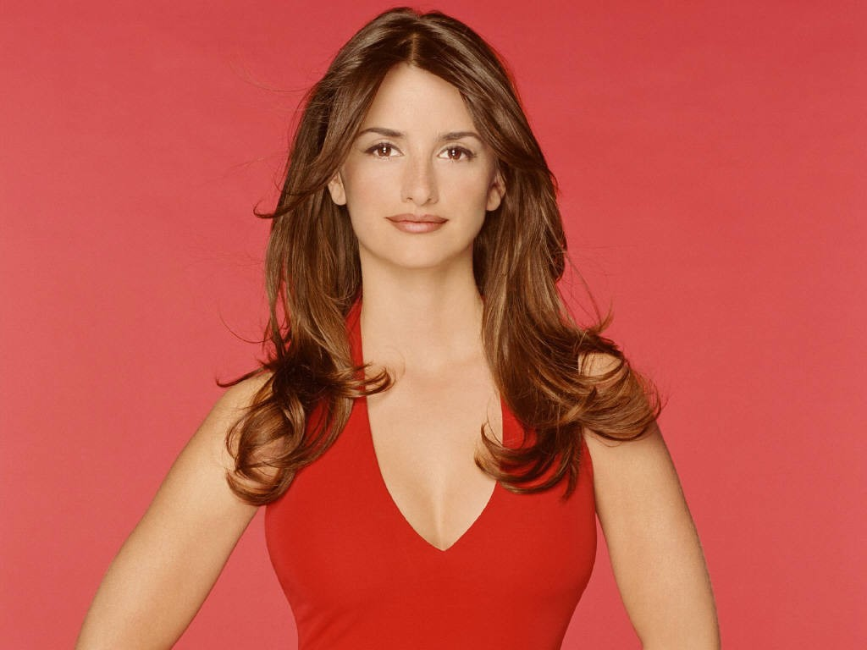
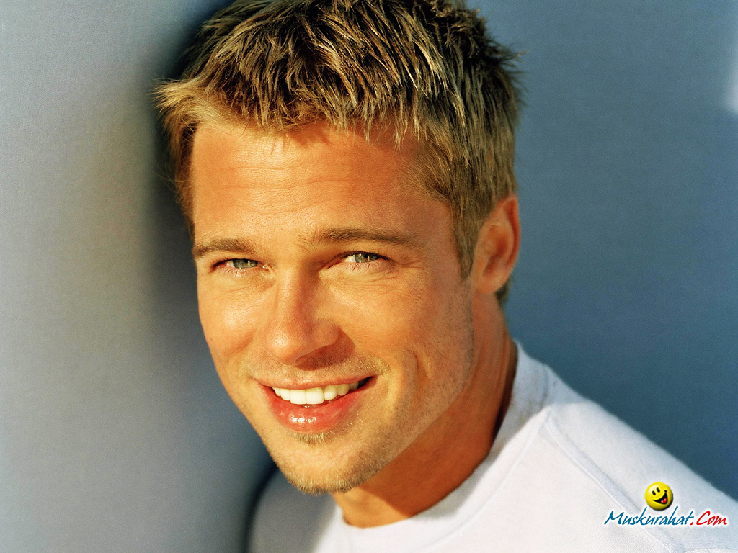

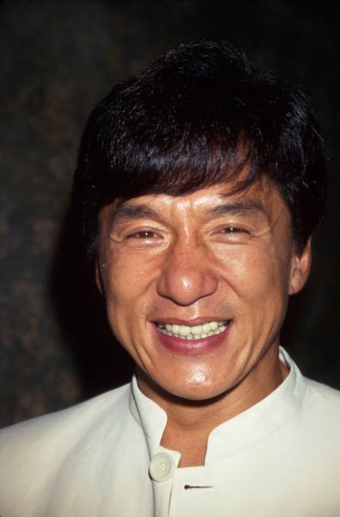
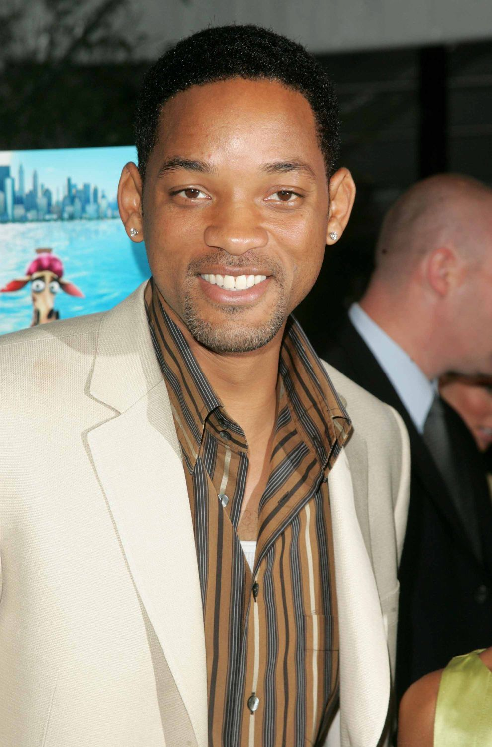
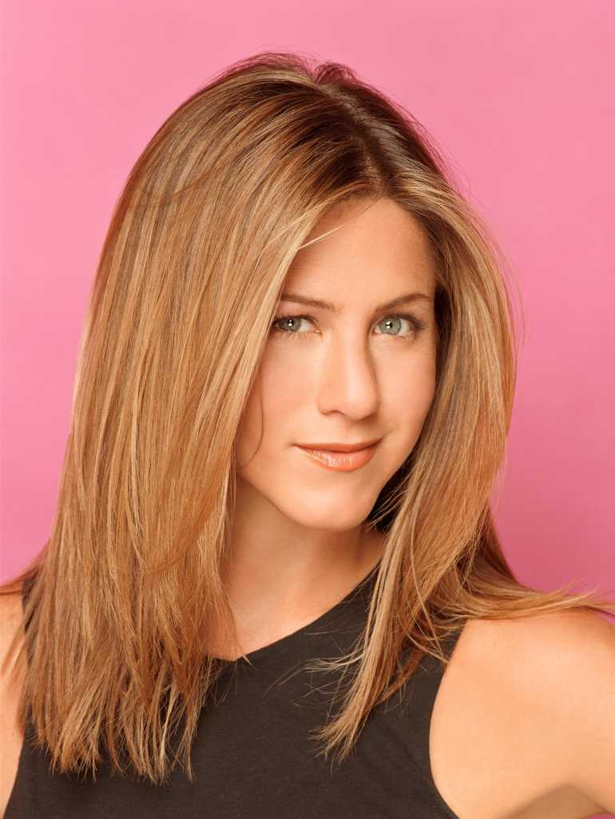
Training simile classifiers
’s eyes
Images of Penelope Cruz
’s eyes
Images of other people
Kumar et. al. ICCV09
Slide: Neeraj Kumar

Slide 24
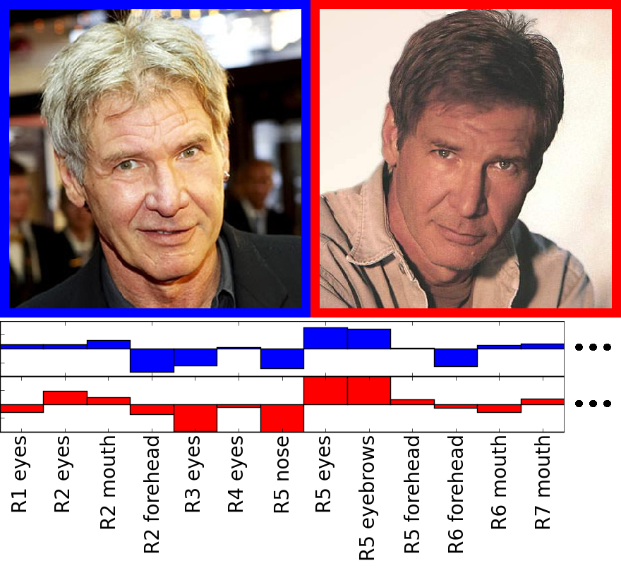
Using simile classifiers for verification
Verification
classifier
Kumar et. al. ICCV09
Slide: Neeraj Kumar

Slide 25
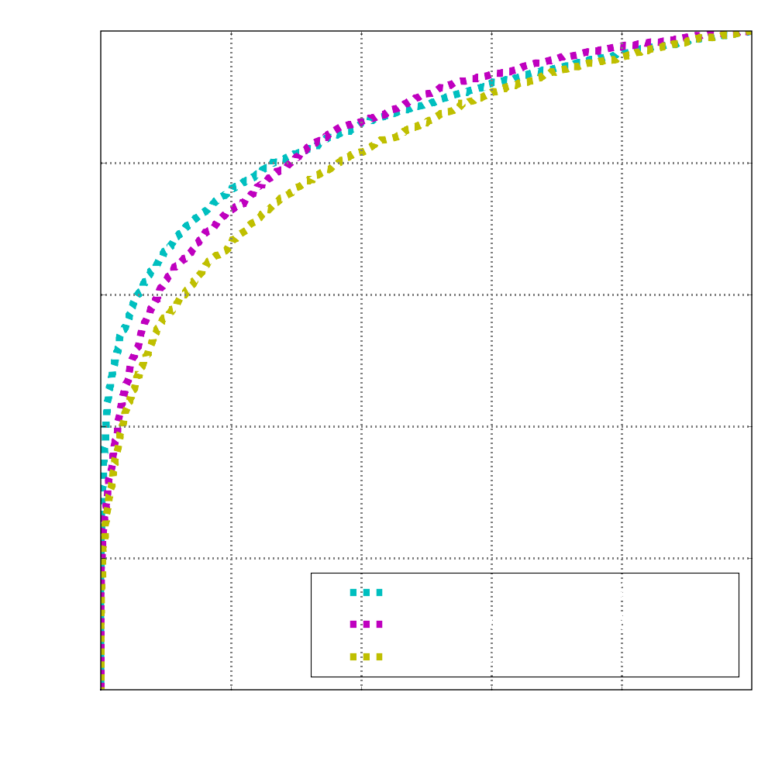
Previous state-of-the-art on LFW
as of May 2009
Slide: Neeraj Kumar
Kumar et. al. ICCV09

Slide 26
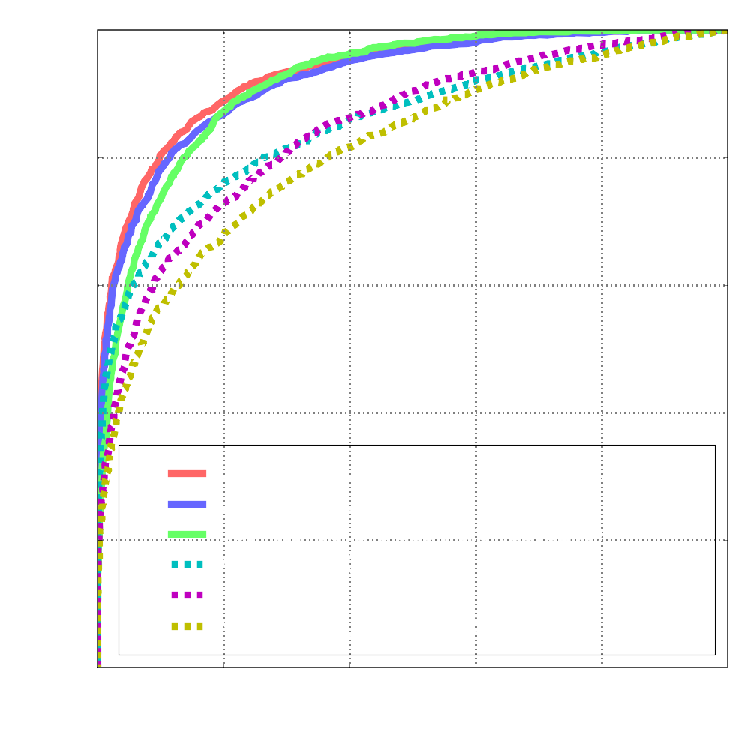
Our performance on LFW
85.29% Accuracy
(31.68% Drop in error rates)
as of May 2009
Slide: Neeraj Kumar
Kumar et. al. ICCV09

Slide 27



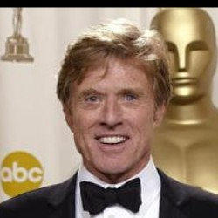
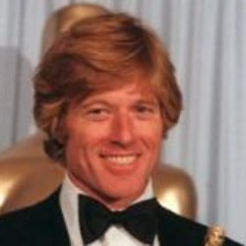
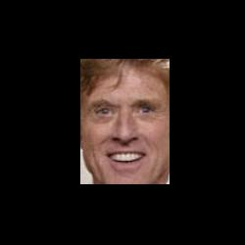
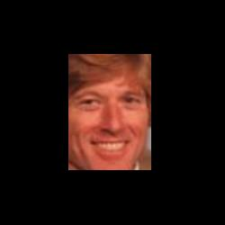
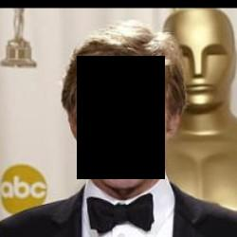
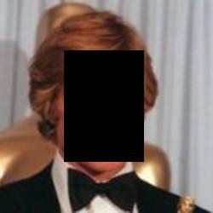
Human face verification performance
Original
99.20%
Cropped
97.53%
Inverse
Cropped
94.27%
Kumar et. al. ICCV09
Slide: Neeraj Kumar

Slide 28
Poselets for Attribute Classification
Slide: Lubomir Bourdev

Slide 29
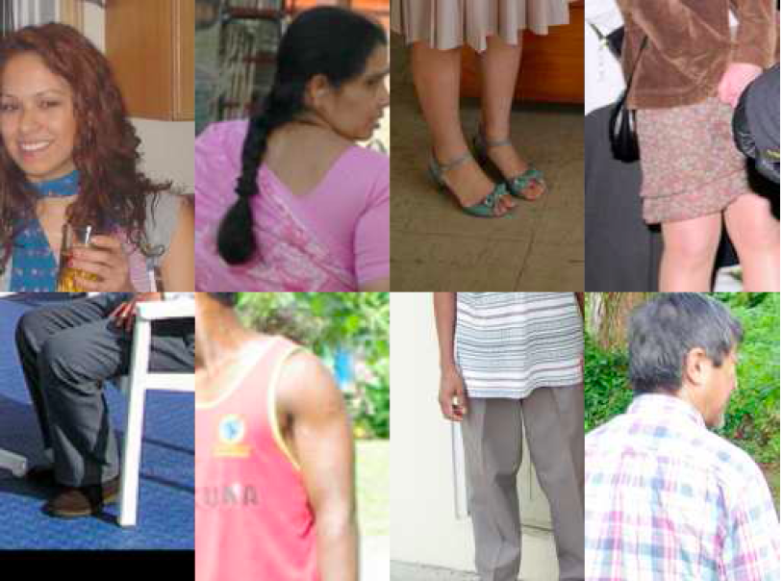
Male or female?
Bourdev et. al. ICCV11

Slide 30






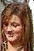




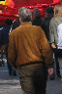
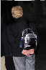

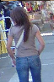

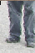
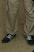
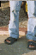

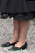
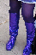


Gender recognition is easier if we factor out the pose
Bourdev et. al. ICCV11
Slide: Lubomir Bourdev

Slide 31
Poselets
[Bourdev & Malik ICCV09]
Bourdev et. al. ICCV11
Slide: Lubomir Bourdev

Slide 32
Poselets
Examples may differ visually but have common semantics
Slide: Lubomir Bourdev

Slide 33

How do we train a poselet?
Slide: Lubomir Bourdev

Slide 34

Finding correspondences at training time
Given part of a human pose
How do we find a similar pose configuration in the training set?
Bourdev et. al. ICCV11

Slide 35
Finding correspondences at training time
Left Shoulder
Left Hip
We use keypoints to annotate the joints, eyes, nose, etc. of people
Bourdev et. al. ICCV11
Slide: Lubomir Bourdev

Slide 36
Finding correspondences at training time
Residual Error
Bourdev et. al. ICCV11
Slide: Lubomir Bourdev

Slide 37





Training poselet classifiers
Residual Error:
0.15
0.20
0.10
0.85
0.15
0.35
Given a seed patch
Find the closest patch for every other person
Sort them by residual error
Threshold them
Bourdev et. al. ICCV11
Slide: Lubomir Bourdev

Slide 38
Training poselet classifiers
Given a seed patch
Find the closest patch for every other person
Sort them by residual error
Threshold them
Use them as positive training examples to train a linear SVM with HOG features
Slide: Lubomir Bourdev

Slide 39
Attribute Classification Algorithm at Test Time
Slide: Lubomir Bourdev

Slide 40
Goal: Extract attributes of this person
Bourdev et. al. ICCV11
Slide: Lubomir Bourdev

Slide 41
Goal: Extract attributes of this person
Input:
Target person bounds
Bounds of other nearby people
Bourdev et. al. ICCV11
Slide: Lubomir Bourdev

Slide 42
Step 1: Detect poselet activations
[Bourdev et al, ECCV10]

Slide 43
Step 2: Cluster the activations
[Bourdev et al, ECCV10]

Slide 44
Step 3: Predict person bounds
[Bourdev et al, ECCV10]

Slide 45
Step 4: Identify the correct cluster
Max-flow in bipartite graph

Slide 46

Start with its poselet activations
Poselet
Activations
Slide: Lubomir Bourdev

Slide 47

Features
Pyramid HOG
LAB histogram
Skin features
Hands-skin
Legs-skin
Poselet
patch
Skin
mask
Arms
mask
B .* C
Features
Features
Poselet
Activations
Slide: Lubomir Bourdev

Slide 48
Attribute Classification Overview
Poselet-level
Attribute
Classifiers
Features
Poselet
Activations
Slide: Lubomir Bourdev

Slide 49
Attribute Classification Overview
Person-level
Attribute
Classifiers
Poselet-level
Attribute
Classifiers
Features
Poselet
Activations
Slide: Lubomir Bourdev

Slide 50
Attribute Classification Overview
Context-level
Attribute
Classifiers
Person-level
Attribute
Classifiers
Poselet-level
Attribute
Classifiers
Features
Poselet
Activations
Slide: Lubomir Bourdev

Slide 51


Visual search on our test set
“Wears hat”
“Female”

Slide 52


“Has long hair”
“Wears glasses”

Slide 53


“Wears shorts”
“Has long sleeves”

Slide 54
“Doesn’t have long sleeves”

Slide 55




baselines
Canny-modulated HOG with SPM kernel [Lazebnik et al CVPR06]
To help the baseline trained separate SPM for four viewpoints:
For each attribute we pick the best SPM as our baseline
Full view
Head zoom
Upper body
Legs
Slide: Lubomir Bourdev

Slide 56

Precision/recall on the test set
Label
frequency
- - - -
___
SPM
___
No
context
___
Full
Model
Slide: Lubomir Bourdev

Slide 57


Confusions
Men most confused as women
long hair
Women most confused as men
hair hidden
baseball hat

Slide 58


annotation
errors
Non-T-shirt most confused to be T-shirt
Short pants most confused to be long pants
Are these pants short?
wrong person
occlusion

Slide 59















Best poselets per attribute
Gender:
Long Hair:
Wears glasses:

Slide 60

We can describe a picture of a person
“A woman with long hair,
glasses and long pants”(??)
Slide: Lubomir Bourdev

Slide 61


Objective
List of attributes
Men’s
Black color
Sweater
Long sleeve
Solid pattern
Low skin exposure
…
Attribute learning
Slide:Andrew Gallagher

Slide 62










Motivation – Shopping Recommendation
Shopping recommendation:
Given a piece of clothing, retrieve similar items from a garment database.
Given a collection of photos, analyze the dressing style for a person / event.
Recommendations
Formal
Sport
Slide:Andrew Gallagher

Slide 63

System Overview
Feature 1
SVM₁
…
…
…
Combine features
SVM
Feature N
SVM_{N}
Pose estimation
A: attribute
F: feature
Attribute classifier 1
F1
Predictions
Blue
Solid pattern
Outerwear
Wear scarf
Long sleeve
F2
A1
F4
Feature extraction & quantization
Attribute classifier 2
A2
A4
F3
…
A3
Attribute classifier M
Multi-attribute CRF inference
…
Slide:Andrew Gallagher

Slide 64



Pose Estimation [Eichner et. al., 2010]
Perform upper body detection, by using complementary results from face detector and deformable part models.
Foreground highlighting within the enlarged upper body bounding box.
Parse the upper body into head, torso, upper and lower parts of the left and right arms.
Slide:Andrew Gallagher

Slide 65


Feature Extraction
SIFT descriptor [Lowe, 2004] extracted over the sampling grid.
SIFT scale = torso area / reference area
SIFT orientation given by the torso stick
Similar procedure for the arm regions.
Slide:Andrew Gallagher

Slide 66



Feature Extraction
Maximum Response Filters (MRF) [Varma 2005]
LAB color
Skin probability
MRF bank
RGB image
Skin probability
Slide:Andrew Gallagher

Slide 67
Feature Extraction
Raw features are quantized using soft K-means (K=5 in our implementation).
Quantized features are aggregated over various body regions, by max or average pooling.
For learning color attributes, the feature is LAB color aggregated from non-skin regions.
Feature type | Region | Pooling method
SIFT | Torso | Average
Texture | Left upper arm | Max
Color | Right upper arm
Skin probability | Left lower arm
 | Right lower arm
Slide:Andrew Gallagher

Slide 68
Feature Fusion
SVM is a kernel-based classification technique.
Feature fusion solution: combined SVM is trained using weighted sum of the kernels.
For all attributes, combined feature consistently outperforms the single best feature.
K₁
K₁
SVM 1
Predict accuracy 1
K₂
SVM Combined
Attribute prediction
K₂
SVM 2
Predict accuracy 2
…
K_{N}
K_{N}
SVM N
Predict accuracy N
Slide:Andrew Gallagher

Slide 69
Recap
Feature 1
SVM₁
…
…
…
Combine features
SVM
Feature N
SVM_{N}
Pose estimation
A: attribute
F: feature
Attribute classifier 1
F1
Predictions
Blue
Solid pattern
Outerwear
Wear scarf
Long sleeve
F2
A1
F4
Feature extraction & quantization
Attribute classifier 2
A2
A4
F3
…
A3
Attribute classifier M
Multi-attribute CRF inference
…
Slide:Andrew Gallagher

Slide 70
Attribute Dependencies
Exploring the mutual relation between multiple attributes potentially offers better classification performance.
Men rarely wear dresses.
Suit should not be short-sleeves.
The presence of necktie strongly indicates the presence of collar. But NOT vice versa (relation is asymmetric).
Slide:Andrew Gallagher

Slide 71
Attribute Inference with CRF
Apply a fully connected CRF on top of the SVM outputs.
Each attribute is a node. All nodes are pair-wise connected.
The edge connecting 2 nodes corresponds to the joint probability of these 2 attributes.
F6
F5
A6
F1
A5
F4
A1
F2
A4
F3
A2
Ai: Attribute i
Fi: Features for Ai
A3
Slide:Andrew Gallagher

Slide 72



No necktie (Wear necktie)
Has collar
Men’s
Has placket
Low exposure
No scarf
Solid pattern
Black
Short sleeve (Long sleeve)
V-shape neckline
Dress (Suit)
Wear necktie
Has collar
Men’s
Has placket
High exposure (Low exposure)
No scarf
Solid pattern
Gray & black
Long sleeve
V-shape neckline
Suit
No necktie
Has collar
Men’s
Has placket
Low exposure
Wear scarf
Solid pattern
Brown & black
No sleeve (long sleeve)
V-shape neckline
Tank top (outerwear)
Slide:Andrew Gallagher

Slide 73
Slide:Andrew Gallagher

Slide 74
Slide:Andrew Gallagher

Slide 75



Application: Dressing Style Analysis
The predicted dressing style of Steve Jobs:
“solid pattern, men’s clothing, black color, long sleeves, round neckline, outerwear, wearing scarf”
Slide:Andrew Gallagher

Slide 76




Application: Dressing Style Analysis
The predicted dressing style of weddings:
Male: “solid pattern, suit, long-sleeves, V-shape neckline, wearing necktie, wearing scarf, has collar, has placket”
Female: “high skin exposure, no sleeves, dress, other neckline shapes, white, >2 colors, floral pattern”
Slide:Andrew Gallagher

Slide 77

Application: Gender Recognition
Gender recognition
Face-based: Project faces in the Fisher space.
Clothing-based: The gender output of our system.
Better gender recognition can be achieved by combining face and clothing.
Slide:Andrew Gallagher

Slide 78

Attributes for Detection
Animal
Vehicle
Four-legged
Mammal
Head
Wheel
Leg
Can run
Can Jump
Is Herbivorous
Facing right
Moves on road
Facing right
Farhadi et. al. CVPR10

Slide 79

Our approach
Find Objects
animal
Part, Category
Detections
Input Image
ear
4-leg animal
nose
Dog
4-legged animal
Has nose
has tail
Lying down
facing camera
Can jump,
Carnivorous
Describe Objects
Farhadi et. al. CVPR10

Slide 80
Detectors
Felzenszwalb et al. 2008 using default parameters
One detector for each part, category
Latent “parts” help detect semantic parts
Farhadi et. al. CVPR10

Slide 81


Finding Objects
Farhadi et. al. CVPR10
Sample of Detections
Votes from Detections
Detectors and location votes learned during training
[Leibe et al. 09], [Maji, Malik 09], [Chum, Zisserman 07], [Veldadi et al. 09], [Bourdev, Malik 09]

Slide 82

Finding Objects
Simple voting scheme
Each detection votes, weighted by confidence
K-means on voted object bounding boxes
Candidate score
logistic regression on sum of votes and localized detector responses
Animal Candidate
Detections that Support Object Candidate
Farhadi et. al. CVPR10

Slide 83
Is generalization across basic categories possible?
Yes!
Farhadi et. al. CVPR10

Slide 84
Is generalization across basic categories possible?
Yes!

Slide 85
familiar
Farhadi et. al. CVPR10

Slide 86
unfamiliar
Farhadi et. al. CVPR10

Slide 87
unfamiliar

Slide 88

unfamiliar
Farhadi et. al. CVPR10

Slide 89
Quantitative Results
Farhadi et. al. CVPR10

Slide 90
Quantitative Results

Slide 91
Animal
Vehicle
Four-legged
Mammal
Head
Wheel
Leg
Can run
Can Jump
Is Herbivorous
Facing right
Moves on road
Facing right
Farhadi et. al. CVPR10

Slide 92



Image Representation: Classemes [Torresani ‘10]
Key-idea: represent each image in terms of its “closeness” to a set of C basis classes (“classemes”)
Each is a classifier for class c
There are 2659 categories, selected from the LSCOM word list, e.g. “helmet”, “straight”, “cd player, …

Slide 93

Object Bank
Li et. al. NIPS 10

Slide 94
Attributes as Intermediate Representation
It is not obvious that having semantic attributes always achieves better numbers in naming tasks
Augmenting discriminative and semantic attributes
Learning the right thing might hurt the performance numbers

